Slide 1

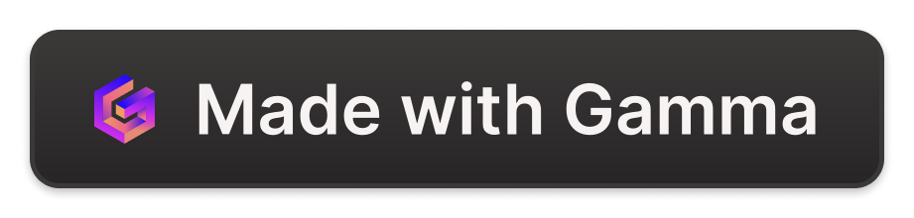
QuickFin
By - Nitant Jatale
QuickFin is an innovative chatbot that leverages Retrieval-Augmented Generation (RAG) to answer queries about financial documents like 10Q and 10K reports. By combining advanced document retrieval with generative AI capabilities, QuickFin aims to revolutionize how users extract and understand key information from lengthy financial reports.

Slide 2

Introduction
1
Brief Overview
Develop a chatbot that leverages Retrieval-Augmented Generation (RAG) to summarize financial documents like 10Q and 10K reports. The chatbot retrieves relevant information from these documents and generates accurate answers based on user queries.
2
Objectives and Goals
- To assist users in quickly extracting and understanding key information from lengthy financial documents. - To combine document retrieval with generative capabilities to provide concise and relevant summaries.
3
Importance and Relevance
Financial documents are complex and time-consuming to read. This tool will assist investors, analysts, and other stakeholders in making informed decisions.

Slide 3

Project Description
Detailed Description
The chatbot will read PDFs of financial reports, chunk the text for efficient processing, and use RAG to combine document retrieval with generative capabilities of language models to provide concise summaries and answers.
Specific Problem
Users need to manually read through extensive financial reports to find relevant information, which is time-consuming and inefficient. GPT-4 gives different results when asked the same question multiple times, showing hallucinations. This behavior is not observed in our RAG based System.
Scope
Includes data ingestion and processing, RAG implementation, and development of a user-friendly chatbot interface.

Slide 4
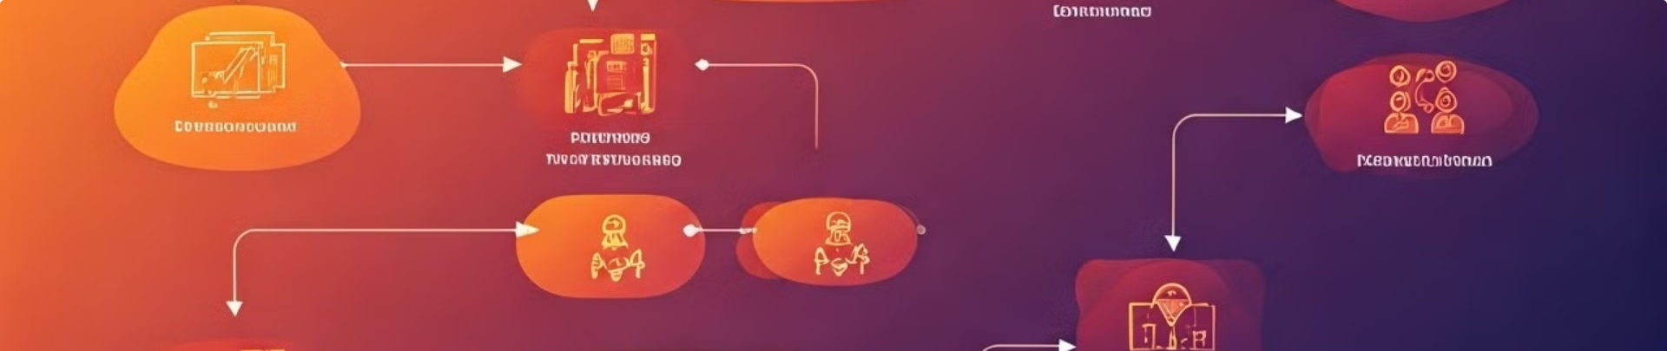
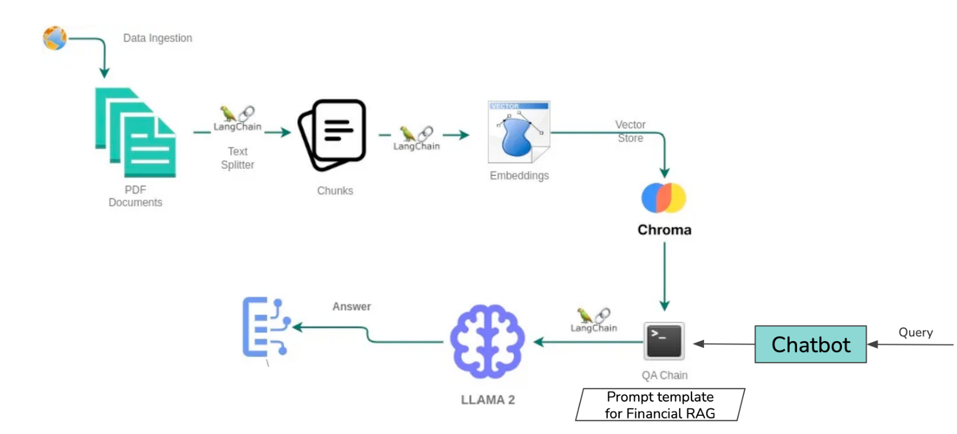
Project Architecture

Slide 5
Project Architecture
1
Data Ingestion
Financial PDFs are ingested.
2
Text Splitting
Documents are split into chunks for efficient processing using LangChain.
3
Embeddings
Text chunks are converted into embeddings.
4
Vector Store
Embeddings are stored in Pinecone for efficient retrieval.
5
Query Handling
User queries are processed by the chatbot, which uses a QA chain to retrieve relevant chunks from Pinecone.
6
Response Generation
LLama 2 model generates concise and accurate answers based on the retrieved chunks and the prompt template for financial RAG.
Technologies: Python, Flask, NLP models (e.g., LLama 2), LangChain, Pinecone, PDF processing libraries.

Slide 6
Data Collection and Preprocessing
Source and Nature
Steps
Techniques
Financial reports (10Q, 10K) available online.
Reading PDFs
Text cleaning, tokenization, and indexing.
Chunking text
Preprocessing for efficient retrieval and generation

Slide 7




RAG Pipeline Implementation
Overview
Combining document retrieval with language model generation to provide accurate and concise answers.
Steps
1. Retrieve financial reports using online sources. 2. Process and chunk the text for efficient retrieval. 3. Implement RAG to generate summaries based on user queries. 4. Integrate with a chatbot for user interaction.
Challenges
Ensuring accuracy and relevance of generated summaries, handling large documents.

Slide 8

Performance Metrics
Key Metrics
Description
Faithfulness
Consistency of generated answers with the document context
Answer Relevancy
Relevance of answers to the user queries no hallucinations
Context Recall and Precision
Accuracy of retrieved context in relation to the ground truth
Methods: User feedback, comparison with financial benchmarks, usage analytics.
Initial Results: Preliminary evaluations on model performance.
Note: GPT-4 gives different results when asked the same question multiple times, showing hallucinations. This behavior is not observed in our RAG system.

Slide 9




Methods to Improve Metrics
Strategies
Enhance text chunking, fine-tune language models, incorporate user feedback.
Changes Planned
Refine preprocessing steps, improve model training, integrate advanced retrieval techniques.
Impact
Improved accuracy and relevance of generated summaries.

Slide 10
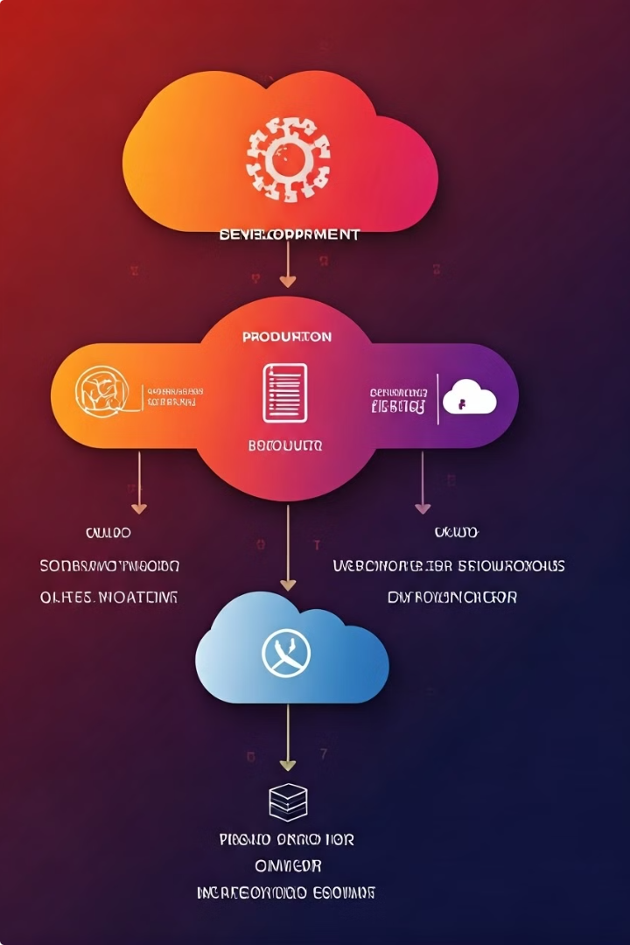
Deployment Plan
1
Steps
System testing, deployment on cloud platforms, continuous monitoring and updates.
2
Tools
Python, Pinecone, Streamlit, Azure.
3
User Testing
Beta testing with classmates to gather feedback and improve the system.

Slide 11

Future Work
1
Extensions
Support for additional financial documents, more sophisticated analysis features.
2
Vision
To become a comprehensive tool for financial document analysis and summarization.
3
Development Beyond Course
Ongoing improvements based on user feedback and evolving technologies.

Slide 12
Conclusion and Q&A
Summary
Q&A Preparation
A chatbot that provides concise summaries of financial documents to assist users in making informed decisions.
Ready to discuss data sources, RAG implementation, and future enhancements.
Key Takeaways
Importance of efficient document processing and accurate information retrieval.
Final Thoughts
Potential to revolutionize how financial information is accessed and understood.

